Slide 1


New York City Tour
Informational Meeting
August 30, 2026
June 1-5, 2027

Slide 2

Trip Brochure

Slide 3
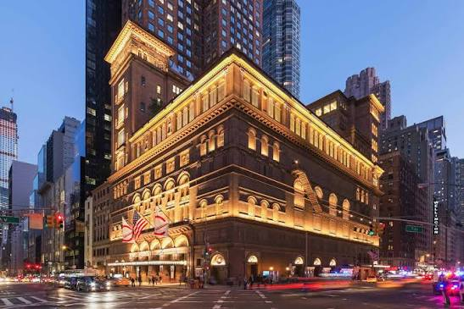
At a glance…
Who can go?
  Any current OYO or Percussion student AND their family members
  Any 2026 OYO or Percussion graduate AND their family members
  Please note, any attendee over 18 who is not a current OYO member will be asked to complete a background check.
  Chaperones will be selected through an application process and receive a discounted price for the trip.
OKYO is partnering with Tulsa Youth Symphony for the performance of one side-by-side piece in Carnegie Hall.
The trip will feature:
  A performance at Carnegie Hall on June 3.
  A concert by the New York Philharmonic.
  Several guided tours.
  A Manhattan dinner boat cruise.
Incredible opportunity, and we want everyone who wants to go to be able to go. We will be offering fundraising opportunities to help students with trip costs.
Carnegie Hall

Slide 4
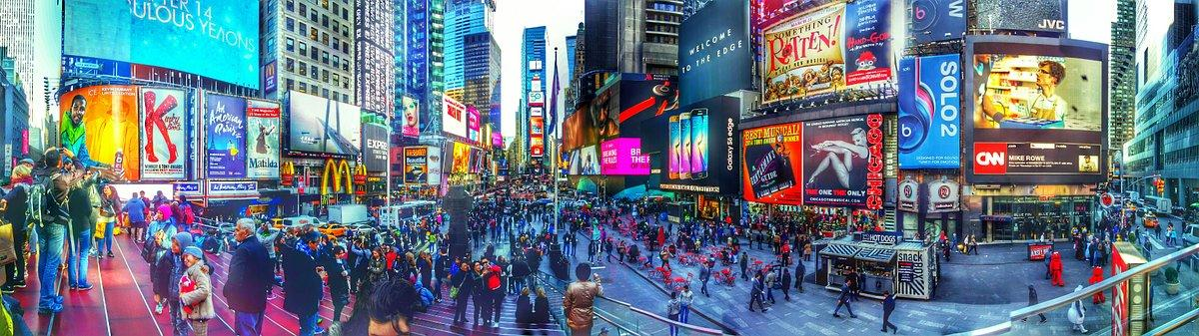
Daily Highlights
All itinerary details are subject to change.
Day 1: Travel to NYC, Check in at hotel, explore Times Square in chaperone groups, dinner
Day 2: NYC Bus Tour, Central Park Tour, NYC Skyline Dinner Cruise

Slide 5
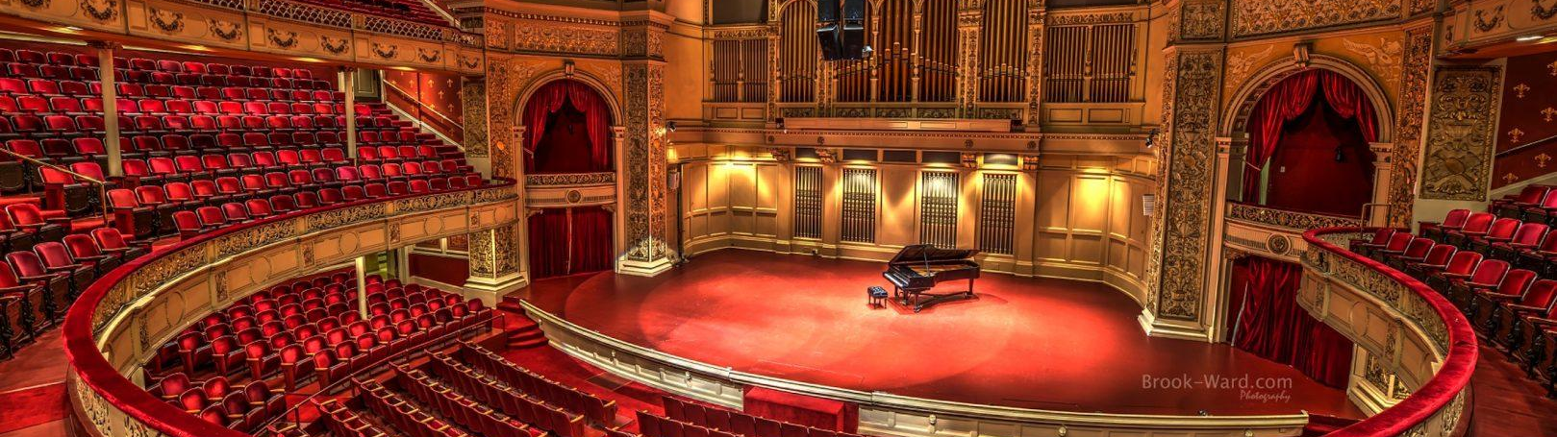
Daily Highlights
Day 3: One World Observatory and 9/11 Memorial Museum
Explore Oculus
Carnegie Hall Concert with Tulsa Youth Symphony!
Group Dinner

Slide 6

Daily Highlights
Day 4:
Chinatown & Canal Street Shopping
Early Dinner at Ellen’s Stardust Diner
New York Philharmonic Performance feat. Gustavo Dudamel conducting Beethoven 9
Day 5: Depart NYC for OKC

Slide 7
Cost & Inclusions
Estimated Cost (subject to change):
Quad Room: $3,274 Triple Room: $3,386 Double Room: $3,610 Single Room: $4,283
**OYO students may NOT stay in a room by themselves. The single is for an adult traveler.
Land Only - should a traveler want to make their own flight arrangements in order to extend their stay in the NYC area, you should expect an approximate $700 discount on the price above.
RT Airfare to/from OKC
One piece of checked luggage not to exceed 50 lbs at no charge
Two carry on items:
  Smaller instruments will be considered carry-on items.
  One additional carry-on item that must fit under the seat in front of you.
Professional tour manager
Tips and Gratuities.
All scheduled group dinners.
Ground transportation throughout New York City.
Instrument rentals (bass, percussion).
Performance fees to play Carnegie Hall.
Admission to all scheduled attractions.

Slide 8
What’s Not Included?
Breakfasts, lunches, snacks, souvenirs
Entrance fees to attractions not outlined in itinerary
Airport taxes & fuel surcharges over $500
Personal services or porterage
Travel insurance
What About Large Instruments?
Basses & Large Percussion Gear will be rented in NYC.
Cellos will be checked. OKYO has access to high quality cello travel cases, and we will have a packing party before we depart.
Horns with detachable bells can be carried on.
Trombones have options - let’s talk.
Tuba will have to be checked.
OKYO will cover all charges associated with checking large instruments.

Slide 9
Pre-Tour Rehearsal and
Preview Concert
Pre-Tour rehearsals will tentatively take place May 17, 20, 24, and 25 from 6pm-8:30pm in Petree Recital Hall at OCU. We will hold a preview concert on the 27th, time TBD.
TENTATIVE Rehearsals:
May 17, 6pm-8:30pm
May 20, 6pm-8:30pm
May 24, 6pm-8:30pm
May 25, 6pm-8:30pm
Rehearsal and Preview Concert: May 27, Time TBD

Slide 10
Payment Schedule
*****October 1, 2026 - Deposit Due - $454 per person (non-refundable)*****
November 11, 2026 - $470 per person
December 11, 2026 - $470 per person
January 11, 2027 - $470 per person
February 11, 2027 - $470 per person
March 11, 2027 - $470 per person
April 11, 2027 - $470 per person
There are some fees associated with paying through the portal. If you would like to pay by check, please call Deana at 281-886-7695

Slide 11
How It Works
Families will register with and make payments directly to Perform America via their online portal. Perform International will track your balance and communicate directly with you regarding payments, forms and other important information needed for the tour.
ONLINE REGISTRATION PORTAL
Notes on Registering:
Participant = Student/Traveler
Buyer = Parent (be sure to use parent email for communication concerning your account)
Payments can be made online w/transaction fee, or call Deana at 281-886-7695 to pay by check
Anyone registering for the trip who is a not a current OYO student should register using the adult package pricing. You will be placed on a waitlist in order for your background check to clear. Once that is completed, you may complete your registration and make your deposit.
Travel Insurance & Cancellation
Several levels of travel protection are offered through Perform America’s registration link. This is not included in the price per traveler, but is available to any traveler wishing to purchase coverage.
Cancellation policy is provided on page five of the brochure.

Slide 12
FAQ’s
Can I fly to New York with the group and when the tour ends, fly home at a later date to extend my stay? Yes, you can purchase the land-only package, and once the group flights are booked, those details will be made available so that travelers can fly with the group on the outbound flights or return flights, whichever the case may be. If this is the case, you will purchase a “Land Only” package.
Can I use my own Frequent Flyer Program Miles? Yes, if you would like to use accumulated miles for your flight, you will need to select Land Only Package and arrange your flights independently.
If my flight arrives or departs separately from the group, can I use the arranged group ground transportation? Unless your flight lands/departs in line with the group flights, you will need to arrange your own ground transportation to/from the airport.

Slide 13
Fundraising
Group Fundraising to offset the cost of the trip for all students including Give Back Nights at local restaurants, online auction, and special events including an alumni event and Young Virtuosos: An Evening of Chamber Music. GOAL: Reduce the trip fees for our students and provide organizational support to OKYO.
Individual Fundraising for students to raise money for their own trip accounts to further help offset their fees. These will feel more like school fundraisers (think World’s Best Chocolates). Staff is working on a timeline for these opportunities and will provide updates as they become available.
The Perform America portal also provides an option to set up a contribution page, where friends and family can contribute toward a student’s trip cost.
Save The Date - First Give Back Night - Sept 28 @ Panda Express Nationwide!

